Slide 1
Conversion API
Shalinee Dutta
Muskan Garg & Tarun Sareen

Slide 2
Agenda
What is Conversion API?
How does CAPI (Meta) work?
Google Enhanced CAPI
Setting up Conversion API Integration
Takeaways

Slide 3
What IS CONVERSION API?

Slide 4
Conversion API
The Conversion API is a way to share events server side, which make Ad tech platform more powerful because the integration is extremely reliable and unencumbered by browser restrictions.
It can receive data even from offline conversions and events, or anywhere within the customer journey.
Nearly all major advertising platforms introducing their own conversions APIs — Facebook CAPI, Google Enhanced Conversions, SnapChat Conversions API and TikTok Events. Pinterest, LinkedIn, Twitter and Amazon are expected to release conversions APIs sometime soon.
The downside to Conversion APIs (e.g. server-side APIs), is that they’re much more time-intensive to set up than simply embedding a web pixel into your website.

Slide 5
How does CAPI work?

Slide 6
How does CAPI work?
Taking example of Meta’s CAPI here
When a user loads your website, the pixel fires at the browser level. With each page the user visits and action the user completes (add to cart, purchase, lead, etc.), the browser sends an update back to Meta Server. From there one can read in Ads Manager how many purchases, leads, add to carts, and so on your ad generated.
With the Conversions API, when a user clicks on a Facebook ad and lands on your website, Facebook will send a unique ID for that user to the server. The server will track the user via this ID as they visit different pages on your website and note if they complete a purchase, opt for a lead magnet, add a product to their shopping cart, and other actions. The server will then send a message back to Facebook saying what action this user ID completed.

Slide 7
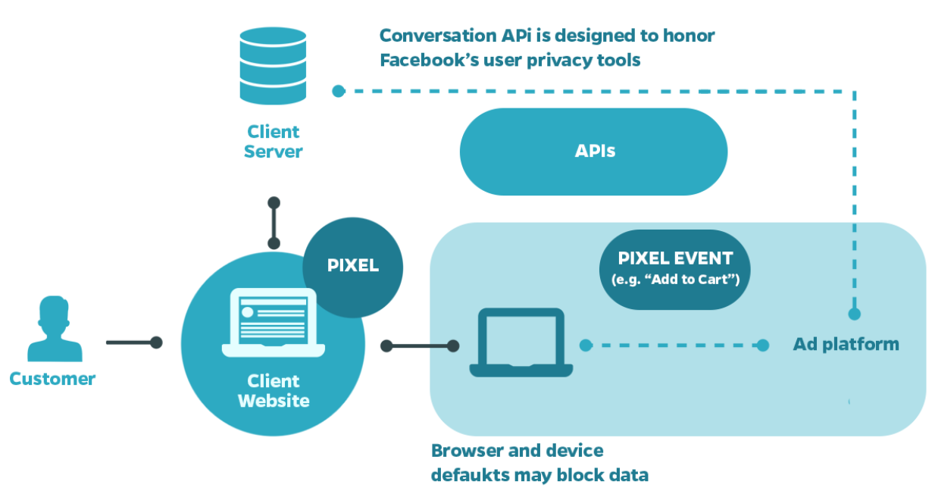

Slide 8
GOOGLE ENHANCED CAPI

Slide 9
Enhanced Conversions
Enhanced conversions is a feature that can improve the accuracy of your conversion measurement and unlock more powerful bidding. It supplements your existing conversion tags by sending hashed first-party conversion data from your website to Google in a privacy-safe way. The feature uses a secure one-way hashing algorithm called SHA256 on your first-party customer data, such as email addresses, before sending to Google.
Benefits:
Give you a better understanding of your customer journeys
Make your conversion data more accurate across your individual campaigns so you know what’s really working
Give you more data that you can use for retargeting campaigns
First-party data can be provided after the conversion event
Notes:
https://support.google.com/google-ads/answer/9888656?hl=en-GB

Slide 10
How It Works?
When a customer completes a conversion on your website, you may receive first-party customer data such as an email address, name, home address and/or phone number. This data can be captured in your conversion tracking tags, hashed, sent to Google in its hashed form and then used to enhance your conversion measurement.
Depending on which type of enhanced conversions you use, the hashed data will be used in different ways to improve your measurement:
Enhanced conversions for web | Enhanced conversions for leads
Relevant for advertisers who want to track sales and events that happen on a website. | Relevant for advertisers who want to track sales that happen off a website (for example, phone or email) from website leads.
Improves measurement of online conversions. | Improves measurement of offline transactions that came from a website lead or visitor.
Allows you to send hashed first-party, user-provided data from your website when a user converts. The data is then used to match your customers to Google accounts, which were signed-in to when they engaged with one of your ads. | Allows you to use hashed, first-party user-provided data from your website lead forms for offline lead measurement. When you upload your leads, the provided hashed information is used to attribute back to the Google Ad campaign.

Slide 11
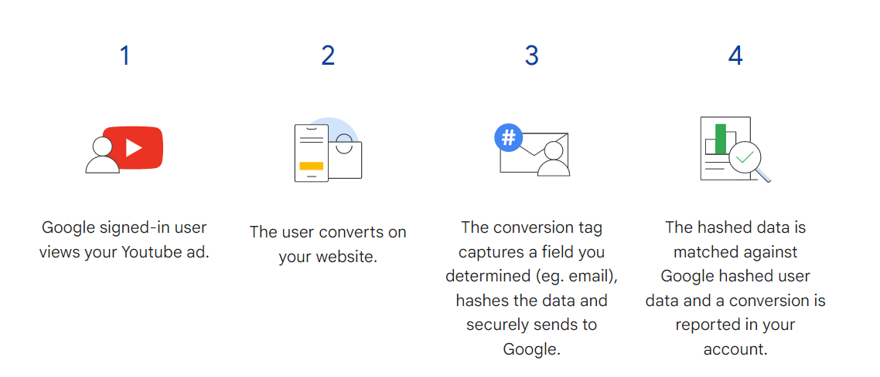
Enhanced Conversion For Web
With enhanced conversions for web, first-party customer data such as an email address, name, home address or phone number is captured in your conversion tracking tags, hashed, sent to Google in its hashed form and then used to match your customers to Google accounts, which were signed-in to when they engaged with one of your ads.
Notes:
About enhanced conversions - Google Ads Help

Slide 12
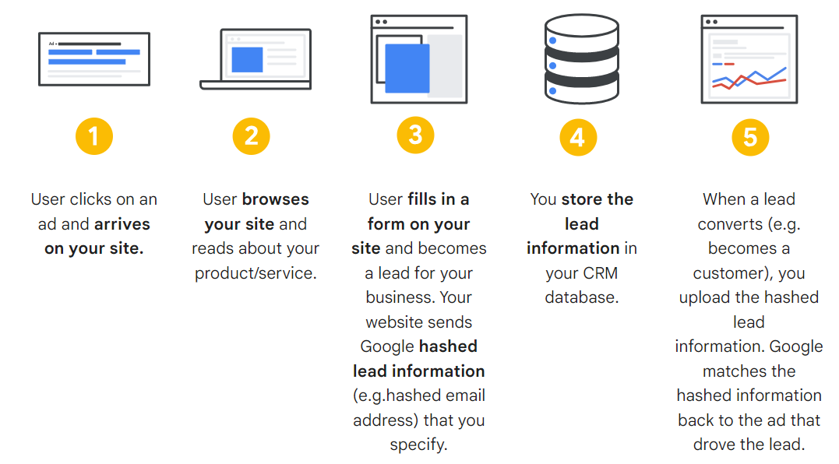
Enhanced Conversion For Lead
You can upload or import conversion data into Google Ads using first-party customer data from your website lead forms. Unlike the standard version of offline conversion imports, enhanced conversions for leads doesn’t require you to modify your lead forms or customer relations management (CRM) systems to receive a Google Click ID (GCLID). Instead, it uses information that was already captured about your leads, like email addresses, to measure conversions.
Notes:
About enhanced conversions - Google Ads Help

Slide 13
Understand with an example
To help demonstrate the process of enhanced conversions, let’s use an example:
A visitor is researching air conditioners using their work laptop and clicks on an ad but doesn’t purchase.
The visitor then leaves work and uses their phone, which is connected to a personal email address; they then revisit the website and purchase an air conditioning unit. The visitor puts information such as their name, address, and phone number into the checkout. The personal data collected is first-party data and what is shared with Google.
The visitor was on their business email while researching air conditioners However, they also use their cell phone to authenticate their email. The authenticator on their phone helps Google match the phone number associated with the purchase with the email they use at work!
Enhanced Conversions then files a single user for this visitor using this first-party data!
If it wasn’t for enhanced conversions, that initial ad that the visitor clicked on might not have gotten any credit for this sale, and Google would have believed there were two users for this single visitor.

Slide 14
How to Setup Enhanced Conversion API?
1. Google suggests 3 ways to set up enhanced conversions for web utilizing their own tools. However, to setup enhanced conversion for leads only initial 2 methods will apply:
Using Google Tag Manager
Using Google Tags
Using Google Ads API
2. On the other hand, big giants like Adobe, Tealium and some other companies are also providing solution to integrate Google Enhanced CAPI on there existing TMS platform with some additional configurations along with costing. The available solutions are:
Adobe Experience Platform Event Forwarding
Tealium Event Stream
Datahash Taghash
3. Also, On can integrated the CAPI directly with there Datawarehouse using Reverse ETL, few companies providing solution and making this integration easy.
Hightouch
RudderStack's Reverse ETL

Slide 15
Prerequisite:
Review and sign the Terms of Service (ToS) before you send enhanced conversions data:
Sign in to your Google Ads account.
In the upper right corner of your account, click the tools icon, and under "Measurement", click Conversions.
Open the conversion action you want to use for setting up enhanced conversions. If you don’t have an existing conversion action in your Google account, create at least one new conversion action.
In the “Enhanced conversions” section at the bottom, click Turn on enhanced conversions.
Click Agree to the compliance statement if this is your first time setting up enhanced conversions. By turning on enhanced conversions you confirm that you comply with our policies. The Google Ads Data Processing Terms apply to your use of enhanced conversions.
Select the required option and click Next. If you click Save and don’t take any further steps within Google Ads, we’ll process the data you send us via API as long as you’ve accepted the Terms of Services.

Slide 16
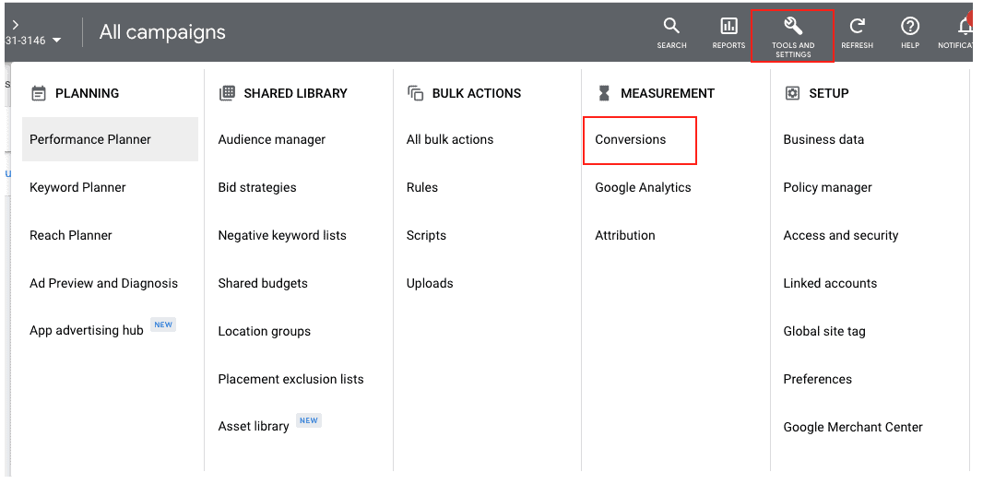

Slide 17
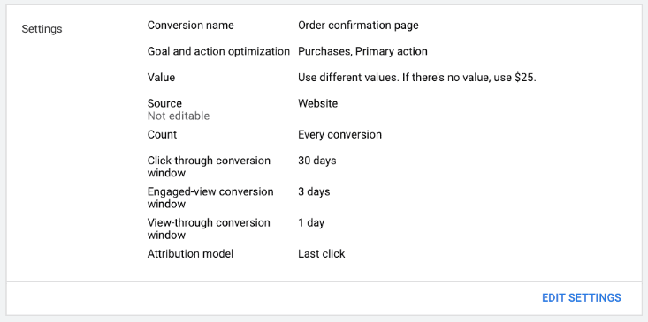
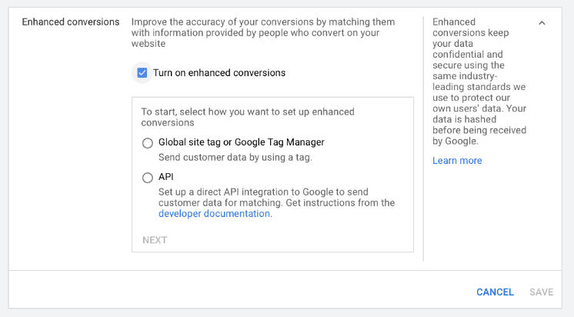

Slide 18
Before We Begin
Make sure that you've Set up conversion tracking for your website either using Google Tag manager or Google tag
Know the conversion page URL where the conversion tag fires (e.g. the confirmation page URL) and the conversion event trigger (for example, a button click or a page view).
Make sure that there is first party customer data available (email, full name and home address and/or phone number) on the page where your conversion tracking tag fires or website lead form.
This implementation requires knowledge of how conversion tracking is set up on your website and some code changes, so make sure that you can speak with your development team as needed.
Ensure that you’ve reviewed the customer data policies and agree to the enhanced conversion terms of service and policies in Google Ads (view steps on this below, under Instructions)
You'll also need to remember for Leads:
Note the URL where the lead form on your website is located. You may need this information during setup.
Make sure that auto-tagging is enabled. Auto-tagging is necessary to import offline conversions.

Slide 19
Setup with Google Tag manager
Using Automatic collection
Using 'Manual Configuration' with CSS Selectors or existing data layer variables – no code changes required on your page
Using the 'Code' method to send all data in a single data object – code changes may be required on your page
Notes:
https://support.google.com/google-ads/answer/10172785

Slide 20
Setup with Google Tag manager – Using Automatic Collection
Steps are as follows:-
Follow the instructions mentioned in slide 14.
Check your website for the Google tag by entering your landing page URL and clicking Check URL.
In 'Tag type' you should be defaulted to either Google Tag Manager or your Google tag to set up website tags that will also be used to set up enhanced conversions.
If you're using the Google tag, you will be defaulted into using the 'Automatic Setup' if available and can complete your setup from this screen. If you're using Google Tag Manager, you can click Save, and open your Google Tag Manager account where you can complete the rest of the set up.
Next, you'll select which pieces of customer information you would like to use for enhanced conversions. At this time, only Email is available, but in the future other options like Address and Phone Number might be available.
Click Save. You will see a notification that Google needs some time to evaluate if your conversion will work properly with the 'Automatic Setup'. You can check back in about 1 week to review the status of your conversion action and see if any action needs to be taken.
This successfully implements enhanced conversions for this conversion action. Repeat these steps for each conversion action where you’d like to implement enhanced conversions.

Slide 21
Setup with Google Tag manager – Using Manual Configuration(CSS Selector)
Using 'Manual Configuration' with CSS Selectors or existing data layer variables – no code changes required on your page (recommended if Automatic isn't available)
To identify the CSS Selectors to input into the enhanced conversion tag fields (for example, email, phone, etc.), please follow these steps. If you already have unhashed variables in your data layer, you can select those instead of creating new CSS variables. If you're not sure, continue through the instructions:
Navigate back to your conversion page tab (don’t close your Google Tag Manager page).
On your conversion page, when you have found the corresponding customer data that you want to send with enhanced conversions, use your mouse to right-click on top of it and select Inspect.
For example, if you are trying to capture an email address, make sure that you are right clicking the email address (e.g. example@email.com) displayed on your conversion page.
You will see the Chrome Developer Tools launch within your Chrome browser.
Within the source code presented in the Chrome Developer Tools page, you will see a portion of the code highlighted. This highlighted code is the page element where you need to extract CSS Selectors for the customer data that you right-clicked in Step 2 of this section.

Slide 22
6.Hover your mouse over the highlighted code and right-click it.
7.Scroll down to Copy, then choose Copy selector.
8.In your other tab, with Google Tag Manager open, paste that text in the 'Element selector' field.
For reference, it should look something similar to but not exactly like this:tsf > div:nth-child(2) > div.A8SBwf > div.RNNXgb > div > div.a4bIc > custEmail
9. Click Save and Repeat steps 2-8 of this section for each different piece of customer data (for example, email, name and address, etc.), by copying the CSS Selector into a new variable for each customer data variable in Google Tag Manager.
10.In Google Tag Manager, click Save.

Slide 23
Setup with Google Tag manager – Using ‘Code’ Method (Identify and define your enhanced conversion variables)
First, you’ll need to make sure that the variables that you need, like email, address and phone number, are available on the conversion page where the Google Ads conversion tag fires. This will likely be the case on conversion pages for purchases, sign-ups and other similar conversion types, which often require customer data. If you are unsure which page this is, you should contact your developer.
Once you’ve confirmed that the information is available, you’ll need to store that customer data on your page as global JavaScript variables, so that they can be used by the enhanced conversions tag.

Slide 24
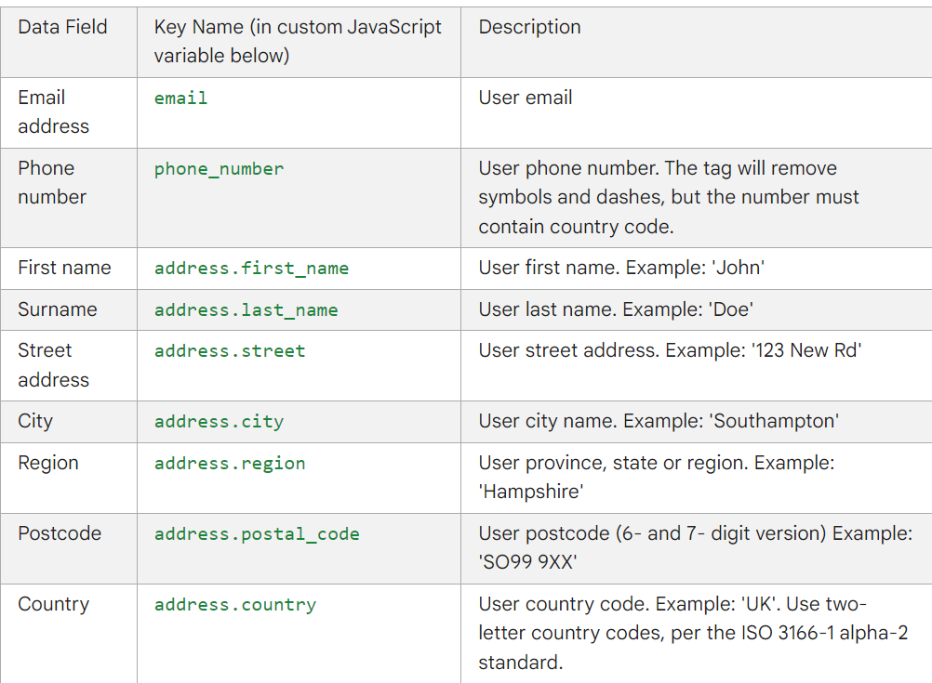
3. This table lists more information about the customer data variables that you can define. You can name the variables however you’d like, and the 'Key Name' column indicates how they will be referenced in the enhanced conversions . Note, all data should be passed as String type variables. Also, when defining name and address, make sure to define each component as an individual variable (for example, first name, last name).
4. The next steps will be to enable enhanced conversions in Google Tag Manager and reference the customer data variables that you just created. It may be helpful to keep the names of your customer data variables handy, as you’ll need them in future steps.

Slide 25
Setup with Google Tag manager – Using ‘Code’ Method(Enable Enhanced Conversion in GTM and create custom JavaScript Variable
Using the 'Code' method to send all data in a single data object – code changes may be required on your page
You can implement enhanced conversions as a single data object using JavaScript variables on your conversion page as long as the customer data that you would like to pass in the enhanced conversions tag (for example, email, phone numbers, etc.) is defined in global JavaScript variables on your conversion page.
This method is useful if you prefer to pass the information using JavaScript variables or if the customer data isn't available on the conversion page (for example, it is available on previous pages and needs to be passed to the conversions page). It is also preferable if you frequently change the formatting on your website, as it’s more resilient to code changes.
Sign in to your Google Tag Manager account and Click Workspace, then click Tags from the navigation menu.
Select the Google Ads conversion tracking tag that you’d like to implement enhanced conversions with and edit that tag
First set up your Google Ads conversion tracking tag in your Google Tag Manager and Make sure that this conversion action has the same conversion tracking ID and label as the conversion action that you enabled enhanced conversions for in your Google Ads account.
Click Include user-provided data from your website.

Slide 26
4. Click Select user-provided data variable, then select New Variable.
5. In the new 'User-provided data variable', select Code at the bottom and select Custom JavaScript under 'Choose variable type'
6. Copy the following code into the custom JavaScript variable:
function () {
return {
"email": yourEmailVariable , // replace yourEmailVariable with variable name that captures your user’s email
"phone_number": yourPhoneVariable , // repeat for yourPhoneVariable and following variable names below
"address": {
"first_name": yourFirstNameVariable
"last_name": yourLastNameVariable ,
"street": yourStreetAddressVariable ,
"city": yourCityVariable ,
"region": yourRegionVariable ,
"postal_code": yourPostalCodeVariable ,
"country": yourCountryVariable
}}}

Slide 27
7. For each type of customer data in the code above, replace the placeholder variables (for example, yourEmailVariable) with the name of the global javascript variable containing that piece of customer data on your conversion page.
As a reminder, at least one of the following fields must be provided:
Email (preferred)
Address (first name, last name, postcode, country are required)
Phone number (must be provided in addition to one of the other two pieces of information above)
Note that if your site doesn't collect one of those fields, remove the field entirely rather than leaving it blank. For example, a website that only collects emails and phone numbers would create a custom JavaScript variable that looks like
this:function () {
return {
"email": yourEmailVariable ,
"phone_number": yourPhoneVariable
}
8. Click Save and You have now set up enhanced conversions for that conversion action. The next step is to validate that it’s working properly.

Slide 28
Setup with Google Tag - Instructions
Sign in to your Google Ads account.
In the upper right corner of your account, click the tools icon Google Ads | tools [Icon], and under "Measurement", click Conversions.
In the “Enhanced conversions” section at the bottom, click Turn on enhanced conversions.
Review compliance statement. To enable enhanced conversions you must confirm that you'll comply with our policies and that the Google Ads Data Processing Terms apply to your use of enhanced conversions. Click Agree to acknowledge your acceptance of these terms.
Click Check URL to check your website for the Google tag.
In “Tag type” you should be defaulted to Use Google tag if that's how you track conversions for this conversion action. Because you used your Google tag to set up website tags, you need to use it to set up enhanced conversions.
Notes:
https://support.google.com/google-ads/answer/9888145

Slide 29
Setup with Google Tag - Set up enhanced conversions for web using Javascript or CSS selectors
To identify the CSS Selectors to input into those fields, follow these steps:
On your conversion page, when you've found the corresponding customer data you want to send with automatic enhanced conversions, use your mouse to right-click on top of it and select Inspect.
If you're inputting the CSS selector for email in Google Ads, make sure you right click the email address displayed on your conversion page.
You'll see the Chrome Developer Tools launch within your Chrome browser.
Within the source code presented in the Chrome Developer Tools page, a portion of the code will be highlighted. This highlighted code is the portion which includes the CSS Selectors for the customer data you right-clicked in Step 2 of this section.
Hover your mouse over the highlighted code and right-click it and croll down to Copy and then choose Selector.
Paste that text in the Google Ads automatic enhanced conversions section (on your other tab) in the corresponding field.
For reference, it should look something similar to but not exactly like this: tsf > div:nth-child(2) > div.A8SBwf > div.RNNXgb > div > div.a4bIc > custEmail
Complete steps 2-6 of this section for each different customer data type (email, name and address, and so on).
In Google Ads, click Save and Enhanced conversions is now set up.
Notes:
https://support.google.com/google-ads/answer/9888145

Slide 30
Setup with Google Tag - Set up enhanced conversions for web by editing your website code
If you currently have conversion tracking implemented using the Google tag directly on your page (not within a third-party tool or iFrame), you can implement enhanced conversions by making slight changes to your Google tag.
Before implementing, make sure that your Tag Type is noted as Google tag, the implementation method is “Edit Code”, and you've chosen the “use event snippet” button when setting up enhanced conversions for this conversion action.
Ensure the fields you need like email, address, and phone number are available on the conversion page where the Google Ads event snippet fires. This will likely be the case on conversion pages for purchases, sign-ups, and other similar conversion types, which often require customer data. If you're unsure which page this is, you should contact your developer.
Notes:
https://support.google.com/google-ads/answer/9888145

Slide 31
Setup with Google Ads API
There are some additional benefits with this approach:
you can use the API to send hashed first-party data up to 24 hours after the conversion event.
This also enables you to locate first-party data from variety of sources, such as a customer database or CRM system.
Below are the high level steps required to setup API:
set up a conversion tracking tag on your website and that you're Using the transaction ID function tag to avoid duplication
Set up a server in your internal system that's capable of sending the data (first-party customer data, conversion data and click identifier data) using an HTTPS connection, the industry standard for secure data transmission.
format the data into a standard format and then hash it using SHA-256 before sending it to Google
Use the Google Ads API to send conversion data to Google.
Notes:
https://support.google.com/google-ads/answer/11062876

Slide 32
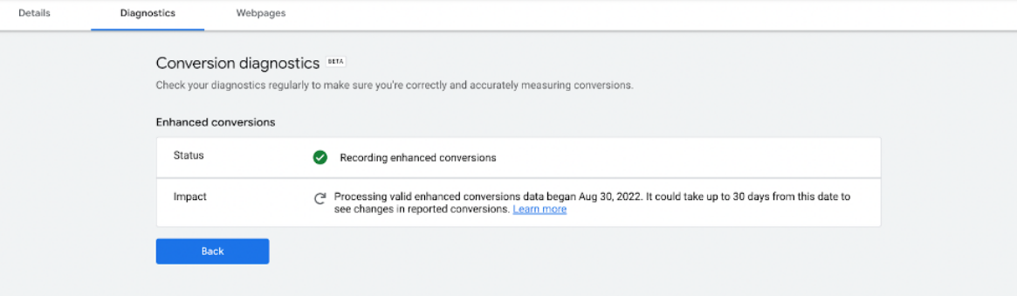
Verify Enhanced Conversion is Running
Once enhanced conversions have been set up, there will be a new status in the ‘Status’ column in Google Ads within your conversions.
It takes a few days for enhanced conversions to be effectively recording conversions. Once that happens, you’ll see ‘Recording (processing enhanced conversions)’ in the status column. You can also see this under your conversion action and Diagnostics tab within Google Ads.
Notes:
https://support.google.com/google-ads/answer/11062876

Slide 33
References:
https://support.google.com/google-ads/answer/9888656?hl=en-GB

Slide 34
thank you
copyright publicis sapient | confidential

